Slide 1




SIMPLE TRACKING SYSTEM
Cumberland County
  ESGI, LLC
  20448 Peckham St
  Ashburn, VA 20147
  www.esgisolutions.com

Slide 2

REGISTRY OVERVIEW
Law enforcement ability to identify, locate, and assist vulnerable citizens.
Cloud-based
Secured, multi-level encryption
HIPAA-compliant
Smart device application (iOS only)
Geolocation and date/time identifier
Image & data matching technology
Customizable

Slide 3
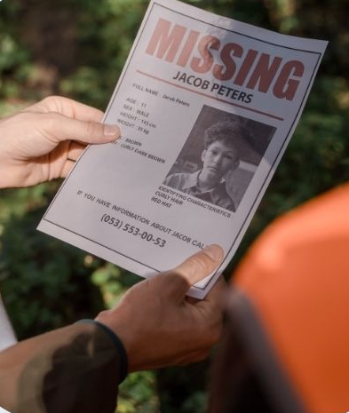
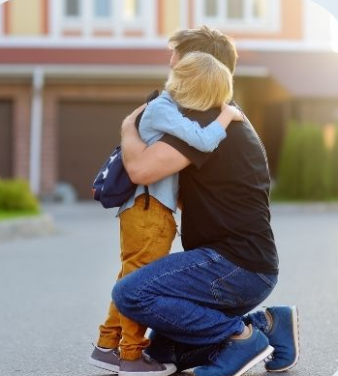
DEMENTIA AND AUTISM REGISTRY
Vulnerable citizens
Community input & engagement
App used in-field
Image or data matching identifies vulnerable citizen
Obtain pertinent information on citizen
Provide assistance and reunite family safely
Notes:
Dementia, Alzheimer’s, Autism, mental health, homeless, drugs

Slide 4
REGISTRY ACCOUNT LEVELS
Administrator
Guest
Data Manager
User

Slide 5
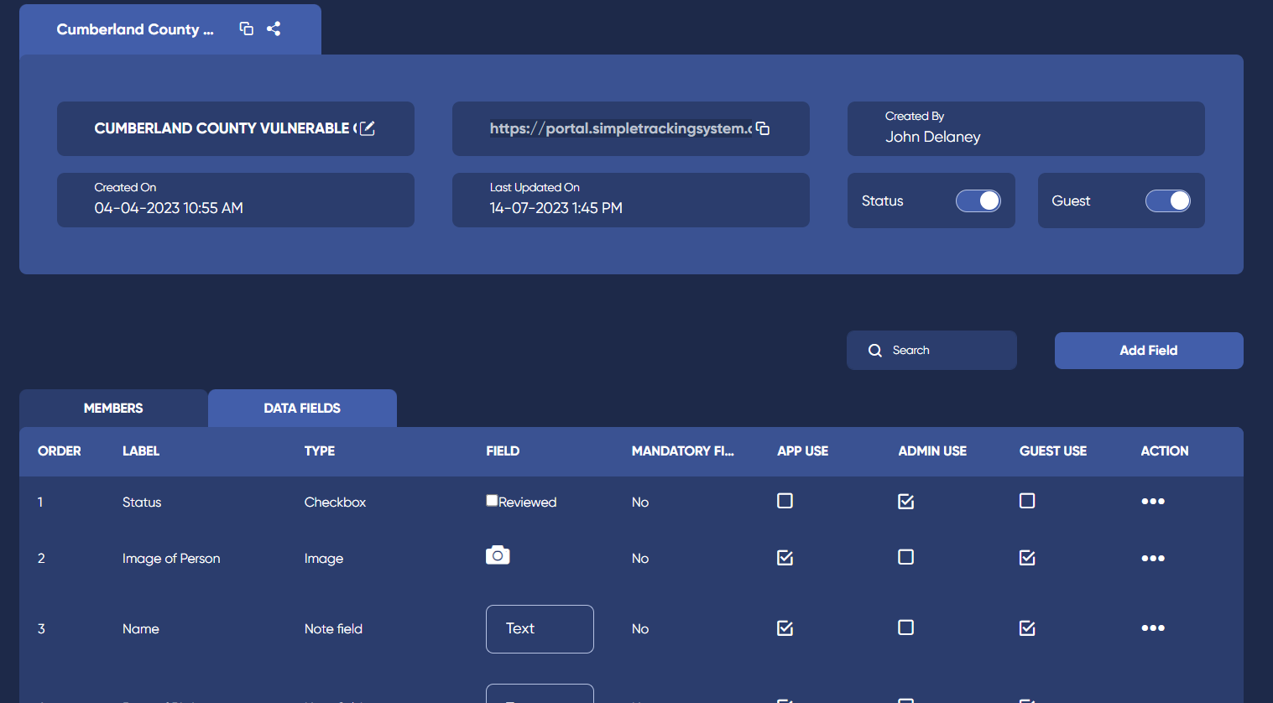
ADMINISTRATOR
Main department POC & SMEs
Add / Delete users
Access to add, update and view registries
Reviews records

Slide 6
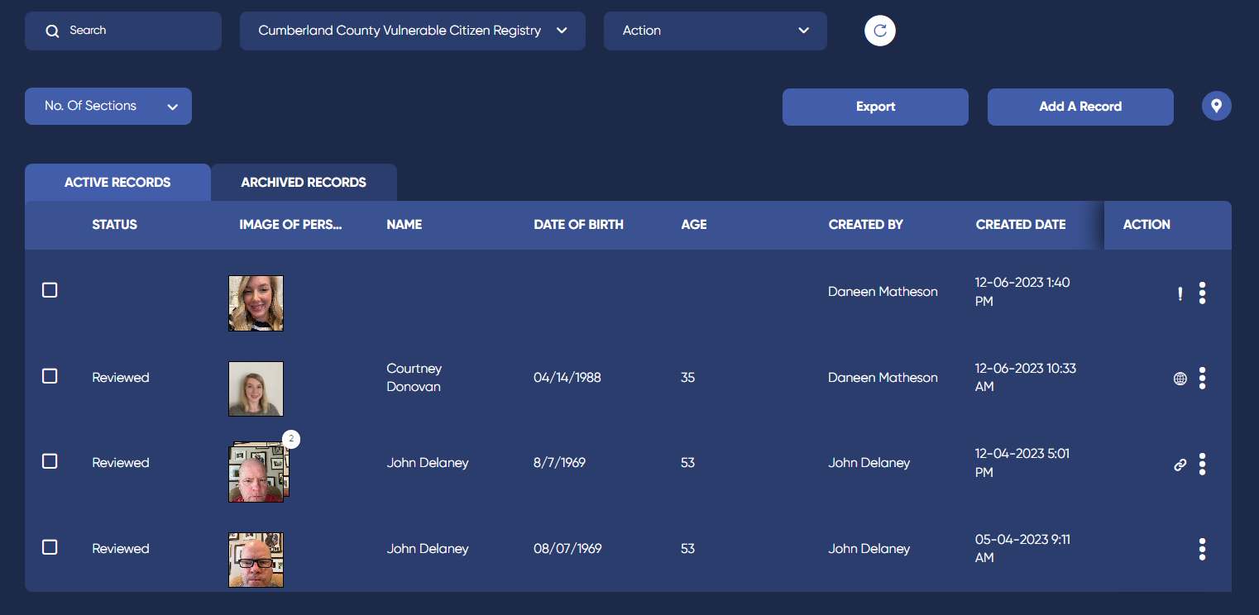
DATA MANAGER
Access to registry
Review records
View and verify potential matches
Export data

Slide 7
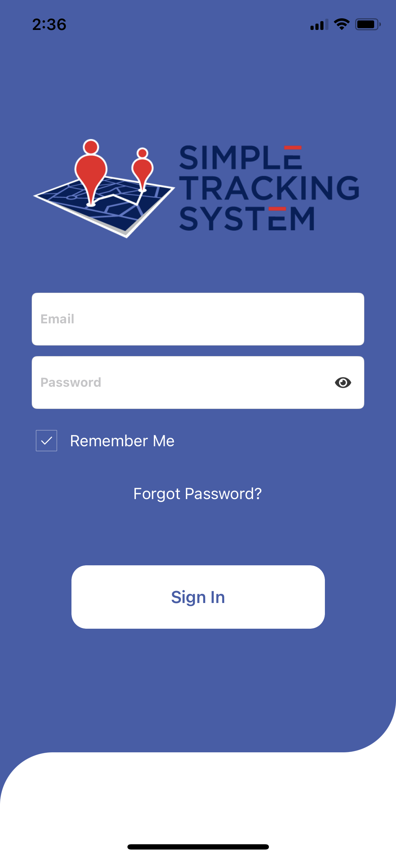
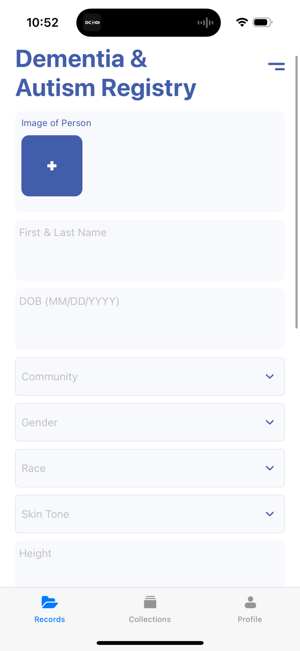
USER
Uses app in-field when in contact with vulnerable citizen

Slide 8
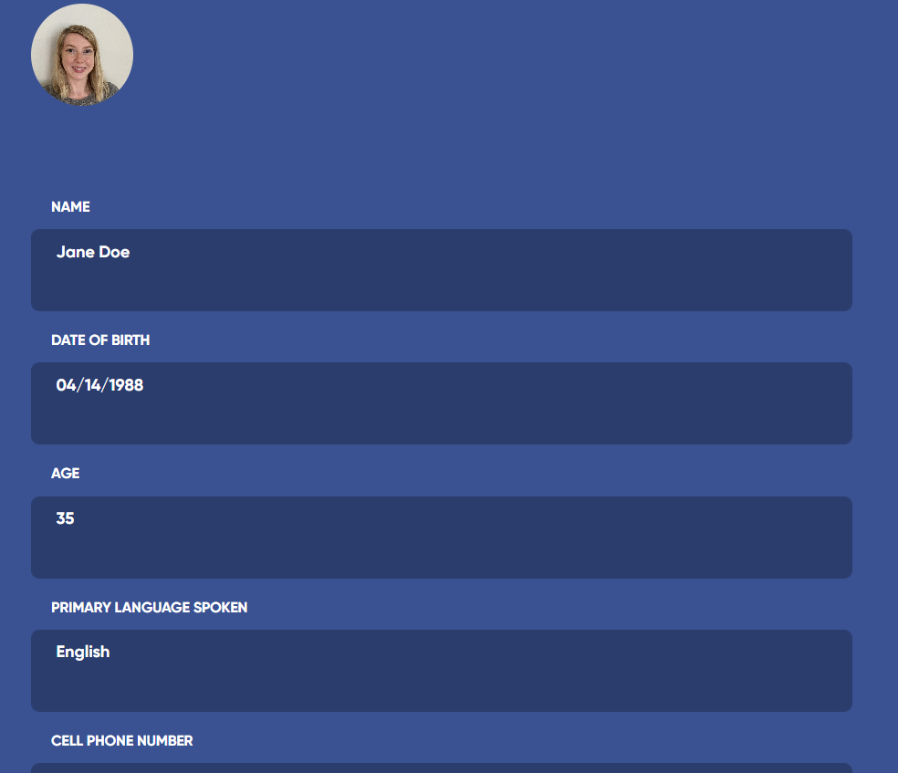
GUEST
Completes record on vulnerable citizen via email invitation
Submits for agency review
Contacted for any follow-up
Updates data annually

Slide 9
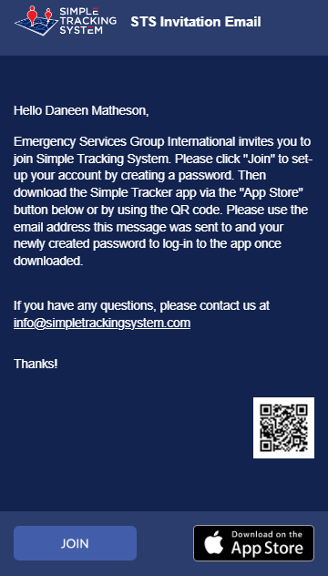
ACCOUNT ACCESS
Email invitation (48-hrs)
Click “Join” to set password
Use email address and password to log-in
MFA after initial log-in
App access available but not necessary

Slide 10
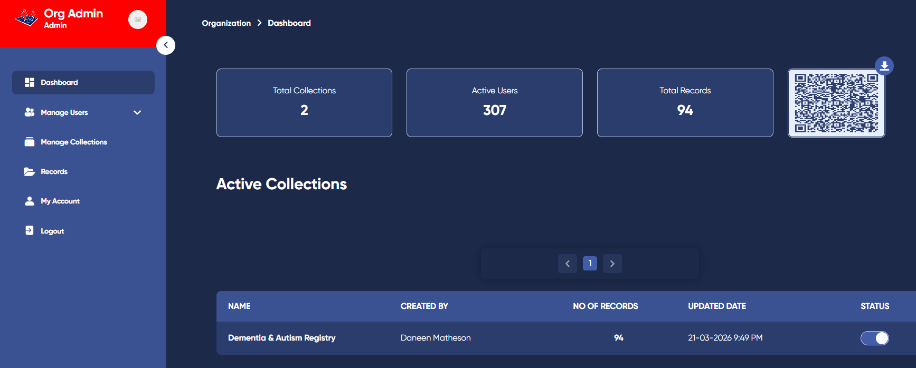
NAVIGATING THE REGISTRY
Dashboard
Manage Users
Collections
Records
Account

Slide 11
DEMENTIA & AUTISM REGISTRY WORKFLOW
Registry populated by community
App used in-field whenever missing person(s) located
Officer prompts ECC to review potential matches
Data Manager reviews/confirms potential match(es)
Record information shared with responding officer(s)

Slide 12
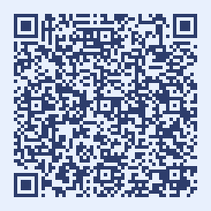
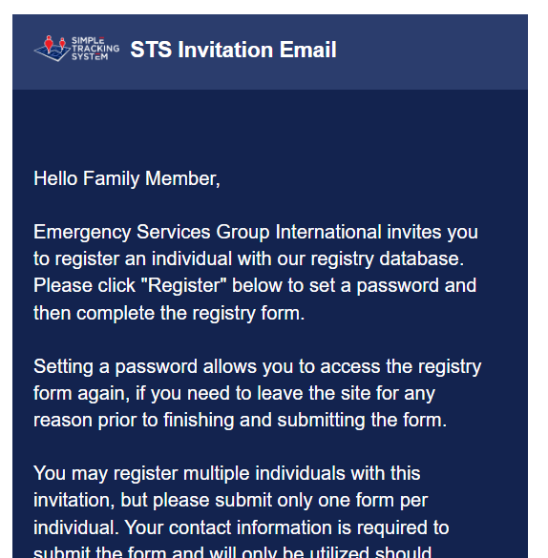
REGISTRY POPULATED BY FAMILY
QR Code functionality
Family submits name and email address
Populates record(s) via email invitation from agency
Contacted by agency for record questions or updates and/or when missing person matches submitted record
Family to update annually

Slide 13
DEMENTIA & AUTISM REGISTRY WORKFLOW
Registry populated by community
App used in-field whenever missing person(s) located
Officer prompts ECC to review potential matches
Data Manager reviews/confirms potential match(es)
Record information shared with responding officer(s)

Slide 14
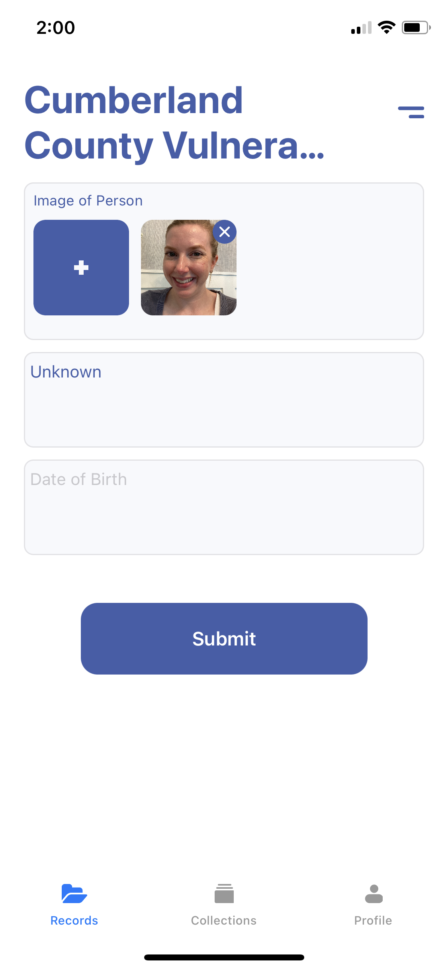
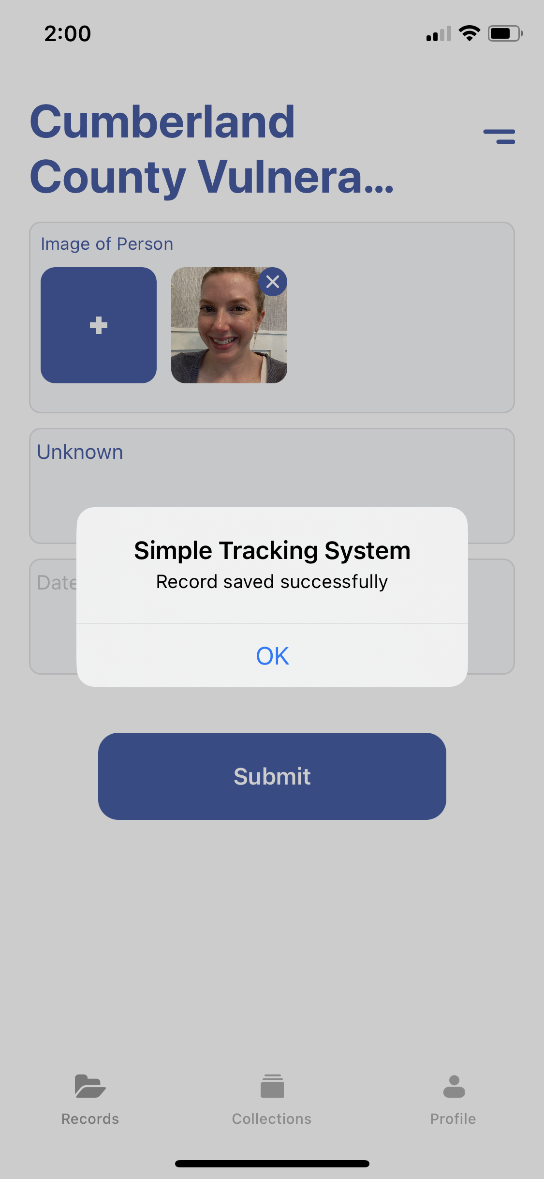
APP USED IN-FIELD
When officer comes into contact with vulnerable citizen, complete record via app
  Take photo of individual
  Any other demographic information
Submit record to registry
Record data wiped from app/device

Slide 15
DEMENTIA & AUTISM REGISTRY WORKFLOW
Registry populated by community
App used in-field whenever missing person(s) located
Officer prompts ECC to review potential matches
Data Manager reviews/confirms potential match(es)
Record information shared with responding officer(s)

Slide 16
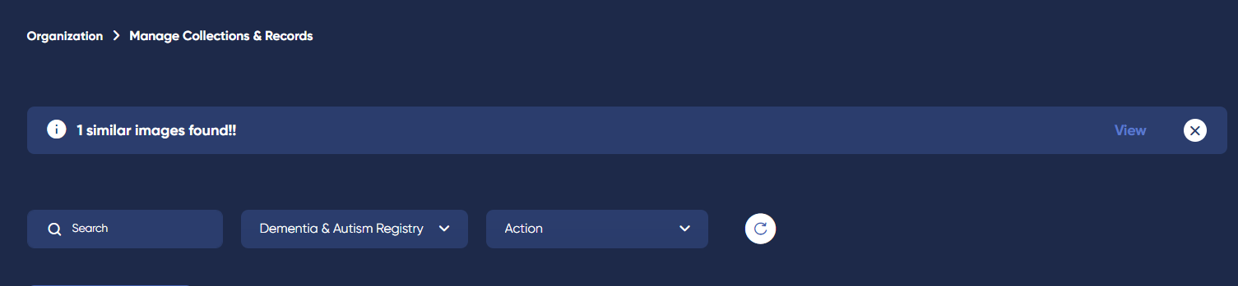
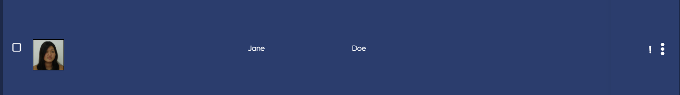
REGISTRY SEARCHES FOR MATCHES
Registry receives records from app
Automatically searches for potential matches
Login
Notifies of potential matches

Slide 17
DEMENTIA & AUTISM REGISTRY WORKFLOW
Registry populated by community
App used in-field whenever missing person(s) located
Officer prompts ECC to review potential matches
Data Manager reviews/confirms potential match(es)
Record information shared with responding officer(s)

Slide 18
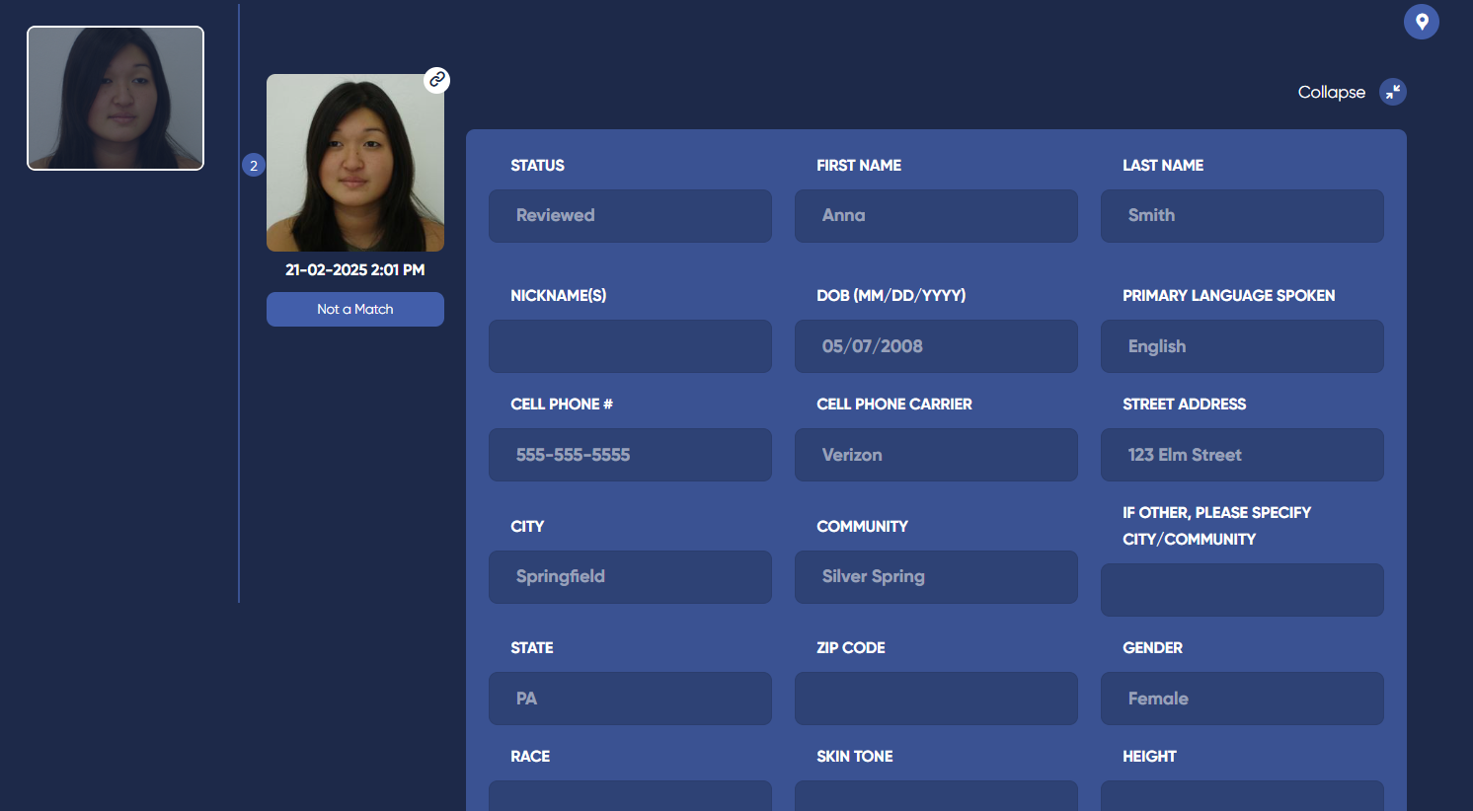
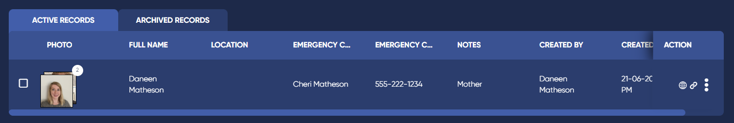
REVIEW IMAGE MATCH
Review matches
Confirm match or decline match
May use corresponding record data, if necessary
Collates records

Slide 19
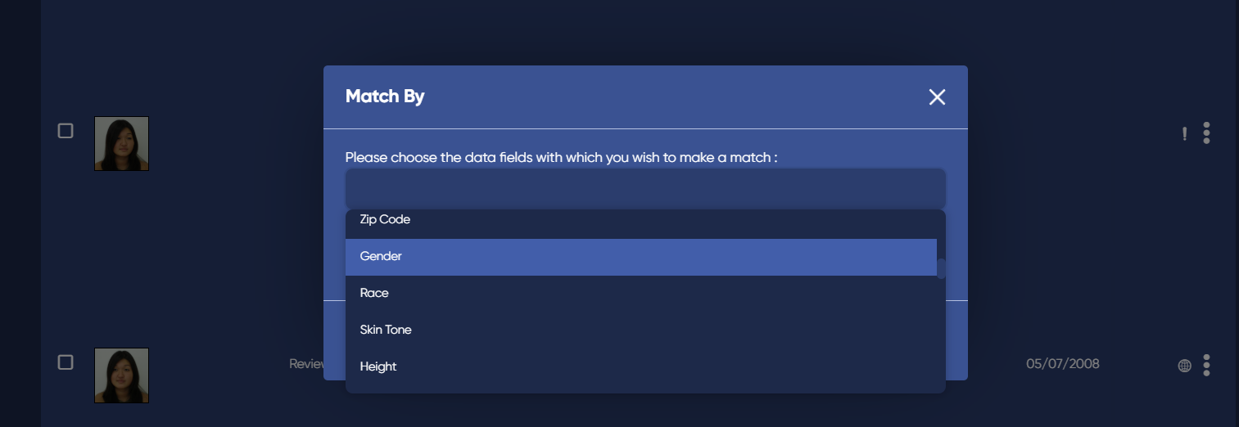
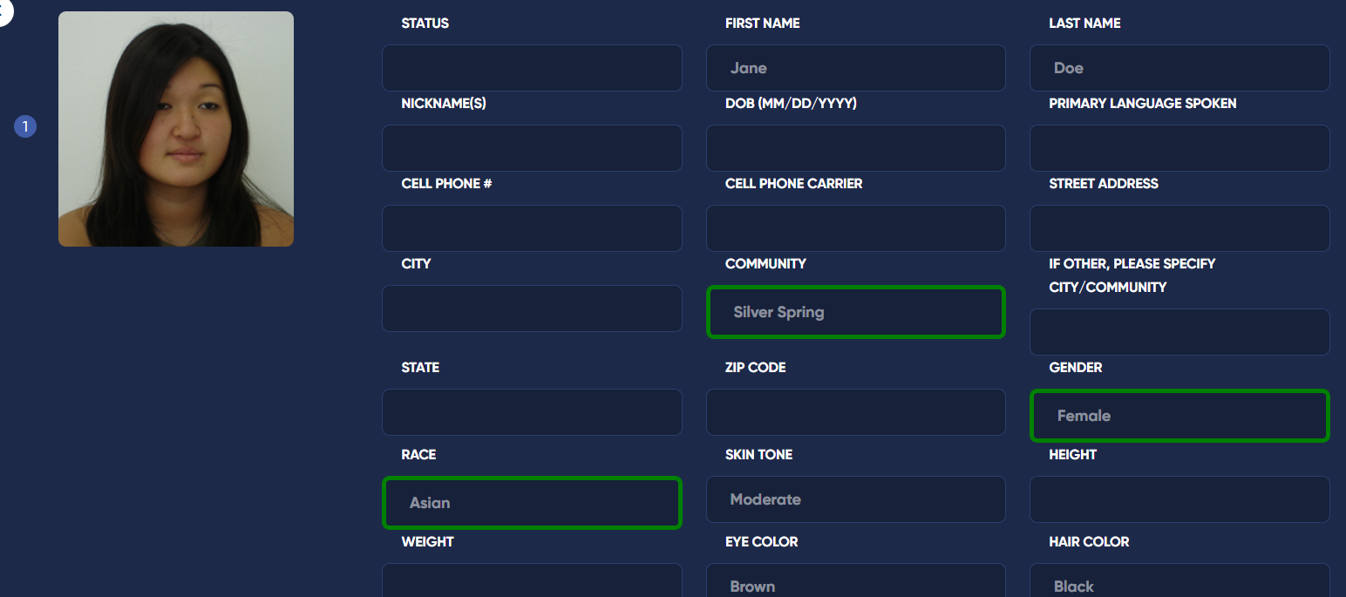
REVIEW DATA MATCH
Prompt data match
Select fields
Review matched data

Slide 20
DEMENTIA & AUTISM REGISTRY WORKFLOW
Registry populated by community
App used in-field whenever missing person(s) located
Officer prompts ECC to review potential matches
Data Manager reviews/confirms potential match(es)
Record information shared with responding officer(s)

Slide 21
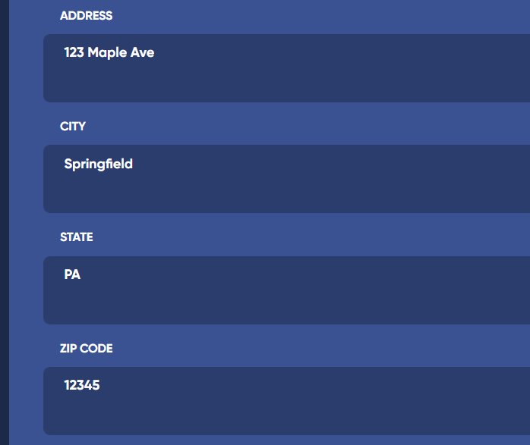
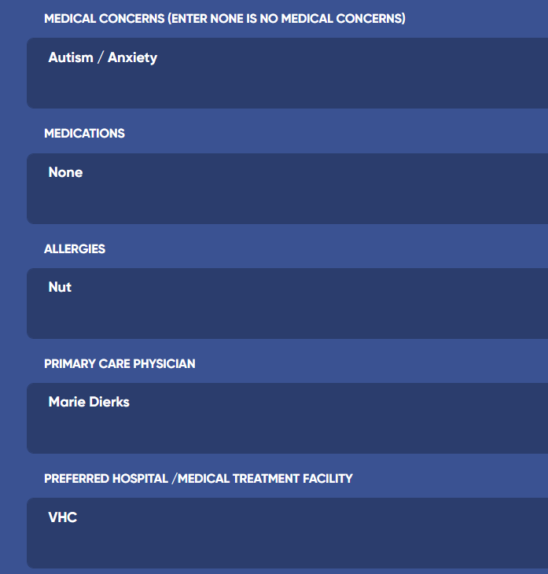
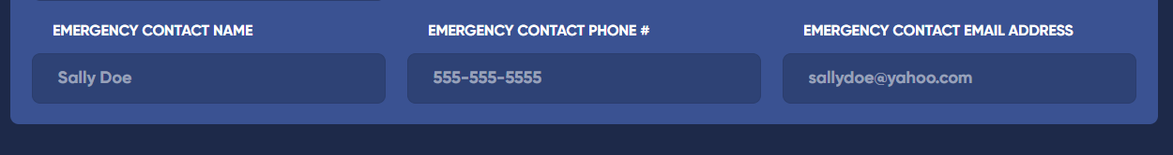
OBTAIN RECORD INFORMATION
If match is verified, review original record for pertinent information
Relay information to officer

Slide 22
RESOURCES
SOP Template
Training Videos
Recordings
Website

Slide 23
QUESTIONS?
  ESGI, LLC
  20448 Peckham St
  Ashburn, VA 20147
  www.esgisolutions.com

