Slide 1




SIMPLE TRACKING SYSTEM
LIVCO Connected
  ESGI, LLC
  20448 Peckham St
  Ashburn, VA 20147
  www.esgisolutions.com

Slide 2

REGISTRY OVERVIEW
Law enforcement ability to identify, locate, and assist vulnerable citizens.
Cloud-based
Secured, multi-level encryption
HIPAA-compliant
Smart device application (iOS only)
Geolocation and date/time identifier
Image & data matching technology
Customizable

Slide 3

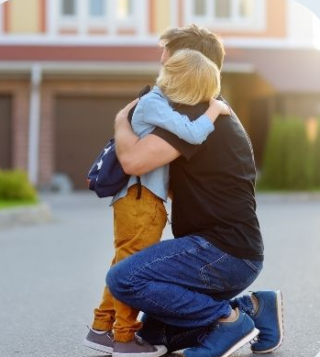
LIVCO CONNECTED
Vulnerable citizens
Community input & engagement
App used in-field
Image or data matching identifies vulnerable citizen
Obtain pertinent information on citizen
Provide assistance and reunite family safely
Notes:
Dementia, Alzheimer’s, Autism, mental health, homeless, drugs

Slide 4
REGISTRY ACCOUNT LEVELS
Administrator
Guest
Data Manager
User

Slide 5
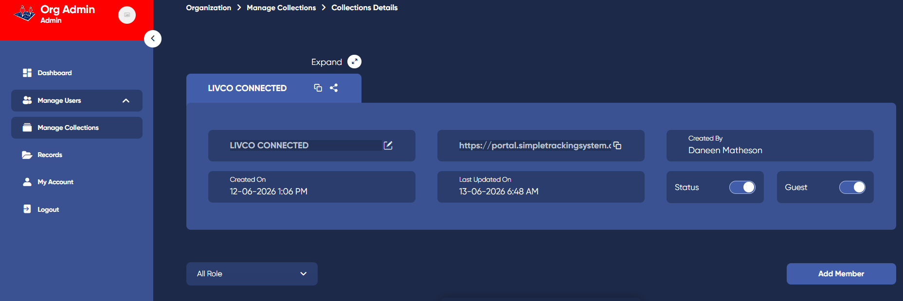
ADMINISTRATOR
Main department POC & SMEs
Add / Delete users
Access to add, update and view registries
Reviews records

Slide 6
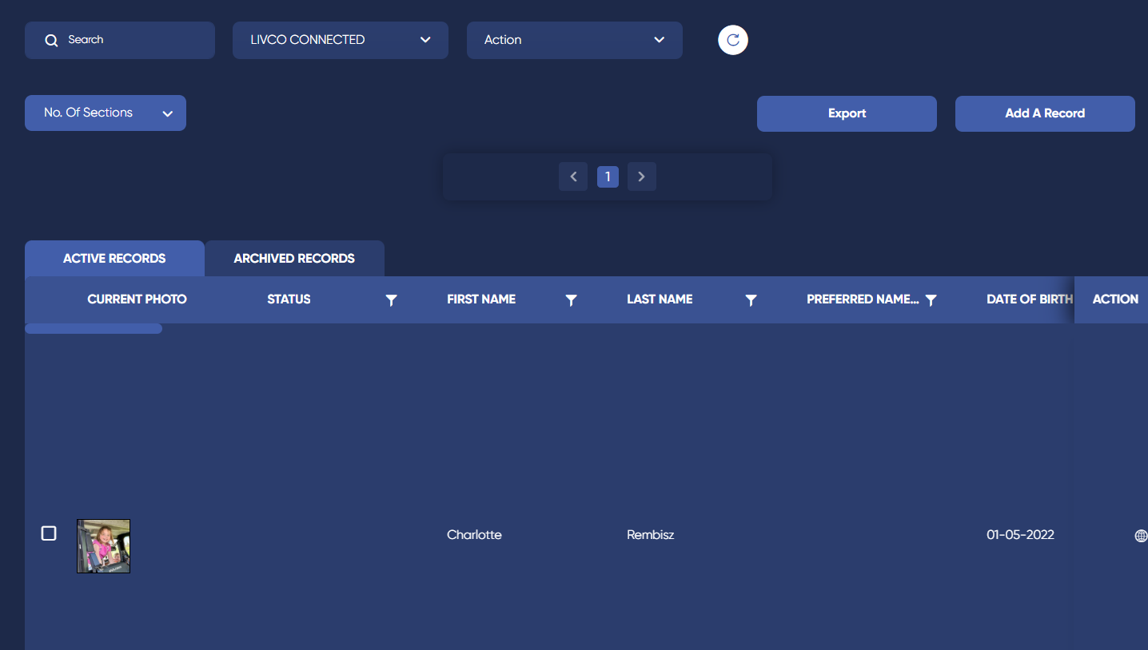
DATA MANAGER
Access to registry
Review records
View and verify potential matches
Export data

Slide 7
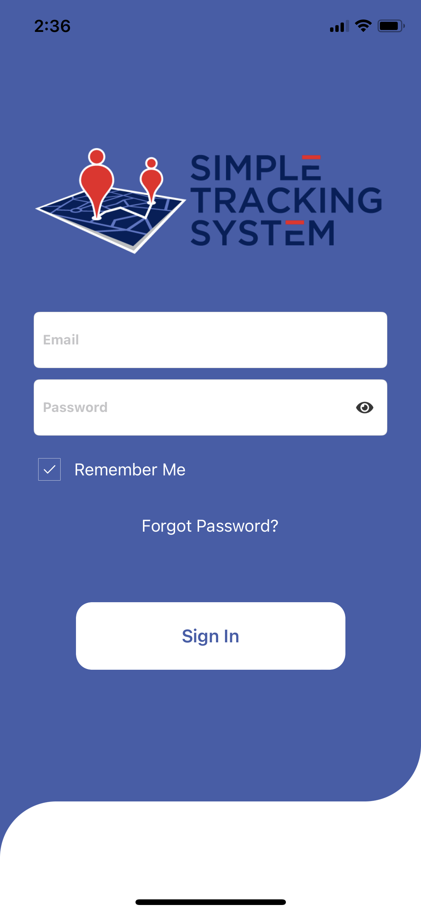
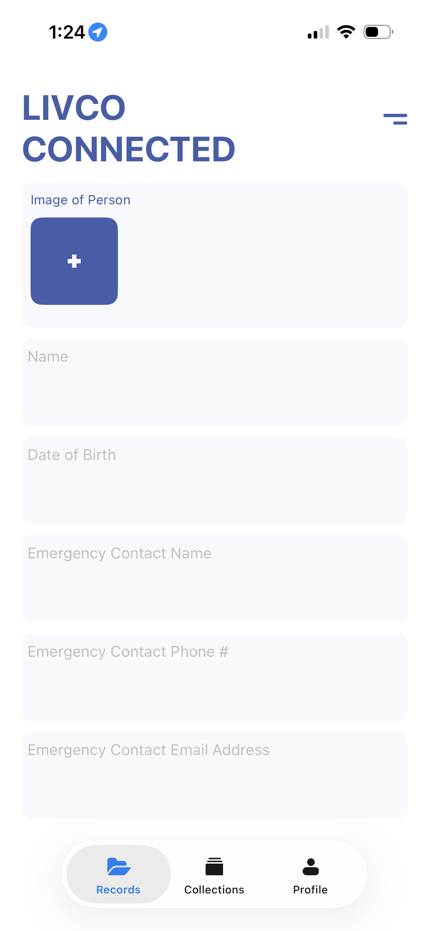
USER
Uses app in-field when in contact with vulnerable citizen

Slide 8
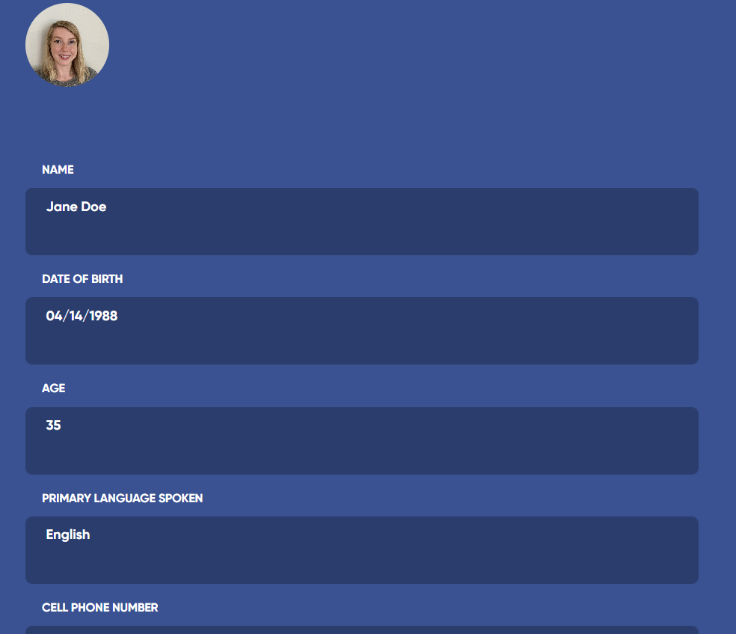
GUEST
Completes record on vulnerable citizen via email invitation
Submits for agency review
Contacted for any follow-up
Updates data annually

Slide 9
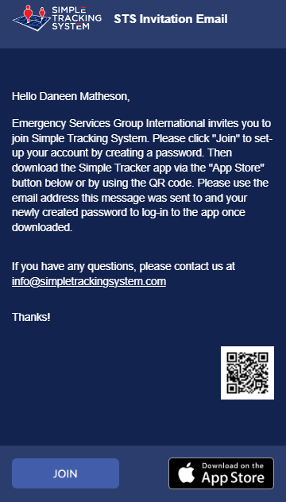
ACCOUNT ACCESS
Email invitation (48-hrs)
Click “Join” to set password
Use email address and password to log-in
MFA after initial log-in
App access available but not necessary

Slide 10
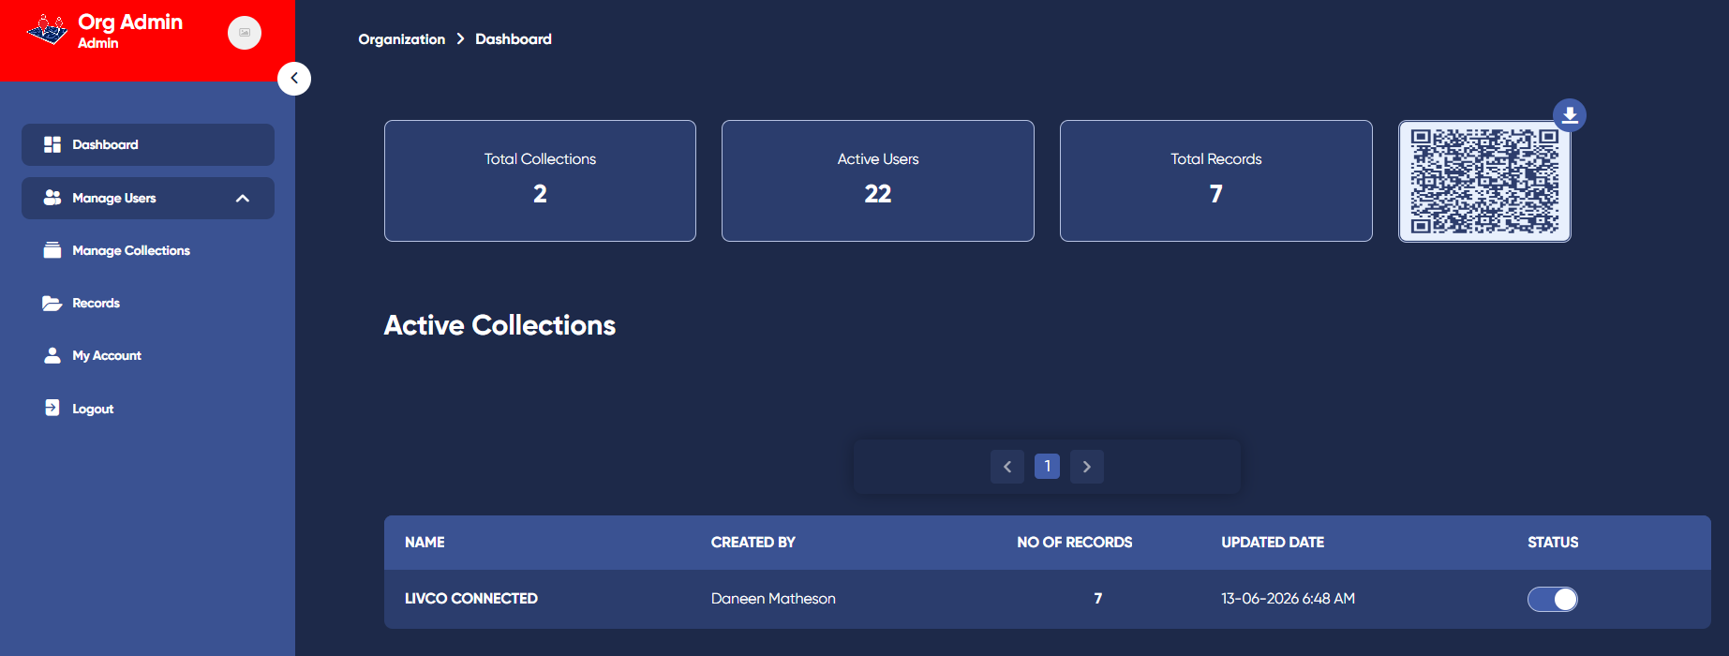
NAVIGATING THE REGISTRY
Dashboard
Manage Users
Collections
Records
Account

Slide 11
LIVCO CONNECTED WORKFLOW
Registry populated by community
Used in-field whenever missing person(s) reported or located
Officer prompts Data Managers to review potential matches
Data Manager reviews/confirms potential match(es)
Record information shared with responding officer(s)

Slide 12
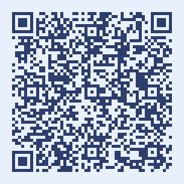
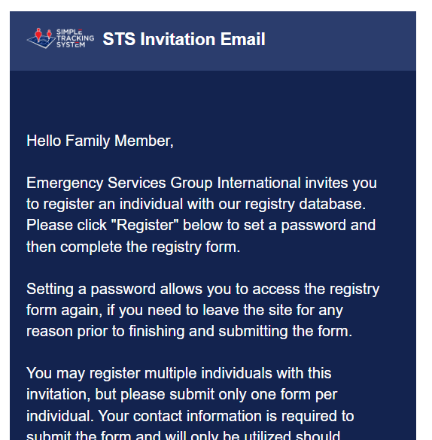
REGISTRY POPULATED BY FAMILY
QR Code functionality
Family submits name and email address
Populates record(s) via email invitation from agency
Contacted by agency for record questions or updates and/or when missing person matches submitted record
Family to update annually

Slide 13
LIVCO CONNECTED WORKFLOW
Registry populated by community
Used in-field whenever missing person(s) reported or located
Officer prompts Data Managers to review potential matches
Data Manager reviews/confirms potential match(es)
Record information shared with responding officer(s)

Slide 14
REPORTED MISSING - RECORD USED
Places They May Go
Calming Tactics
Best Way to Communicate
Stressors
Best Way to Approach
If agency is contacted about a missing person who has a registry record
Access record for pertinent information
Share with public safety and partners assisting in search

Slide 15
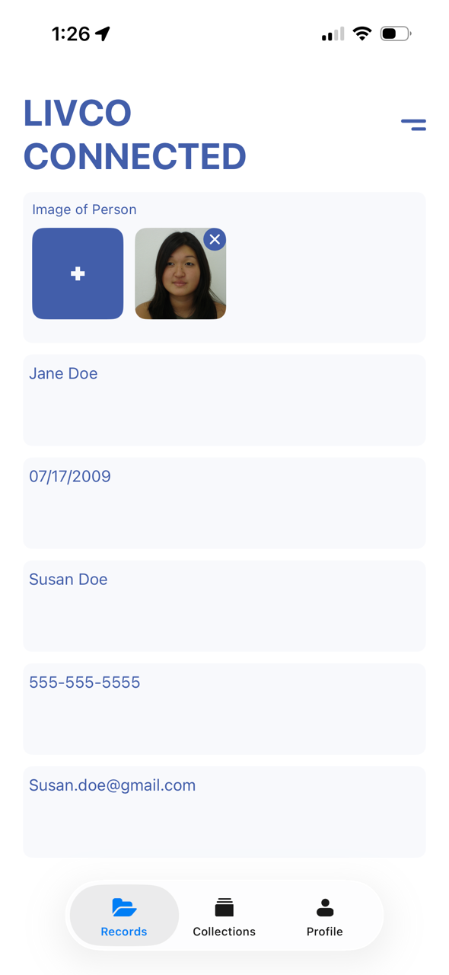
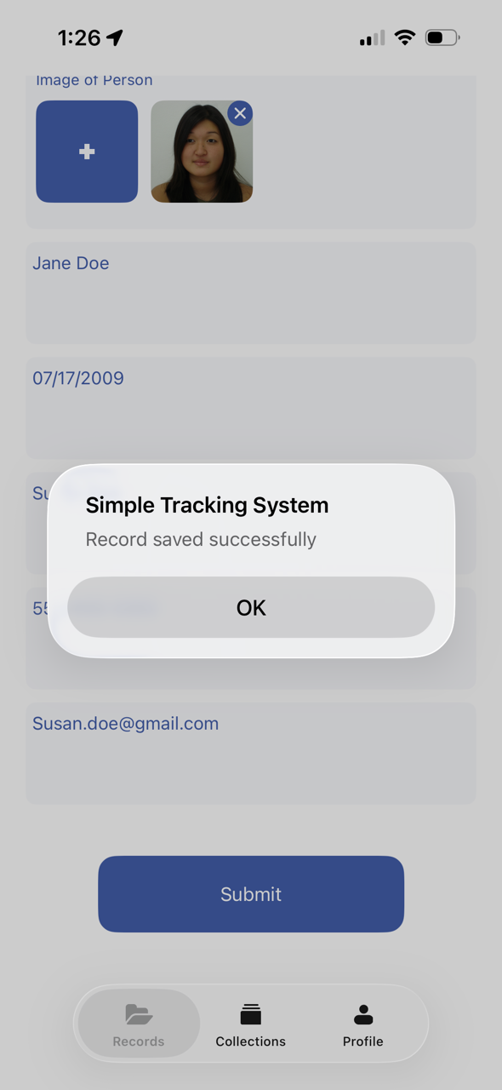
MISSING LOCATED - APP USED
When officer comes into contact with vulnerable citizen, complete record via app
  Take photo of individual
  Any other demographic information
Submit record to registry
Record data wiped from app/device

Slide 16
LIVCO CONNECTED WORKFLOW
Registry populated by community
Used in-field whenever missing person(s) reported or located
Officer prompts Data Manager to review potential matches
Data Manager reviews/confirms potential match(es)
Record information shared with responding officer(s)

Slide 17
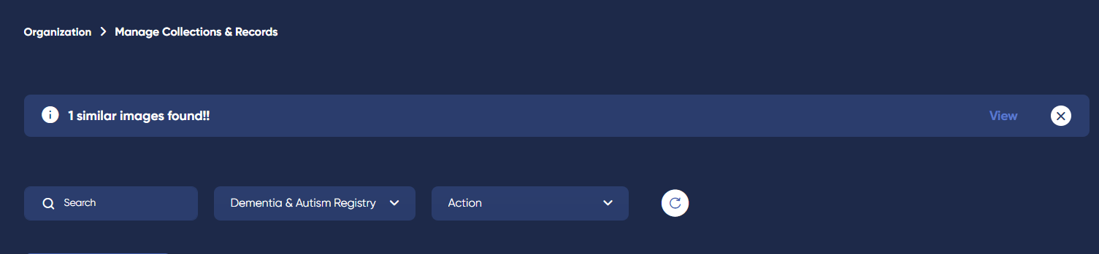
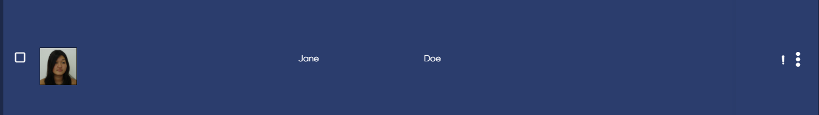
REGISTRY SEARCHES FOR MATCHES
Registry receives records from app
Automatically searches for potential matches
Login
Notifies of potential matches

Slide 18
LIVCO CONNECTED WORKFLOW
Registry populated by community
Used in-field whenever missing person(s) reported or located
Officer prompts ECC to review potential matches
Data Manager reviews/confirms potential match(es)
Record information shared with responding officer(s)

Slide 19
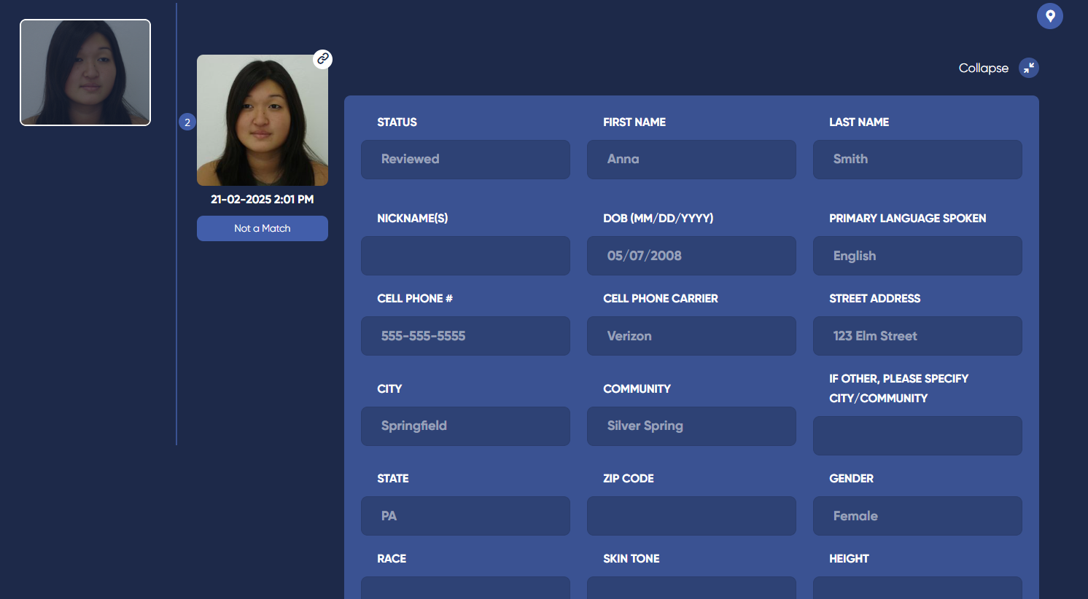
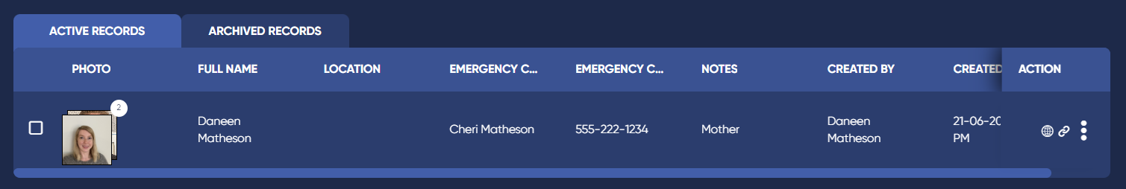
REVIEW IMAGE MATCH
Review matches
Confirm match or decline match
May use corresponding record data, if necessary
Collates records

Slide 20
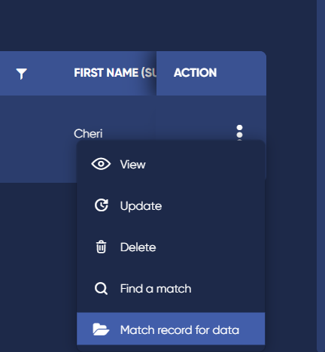
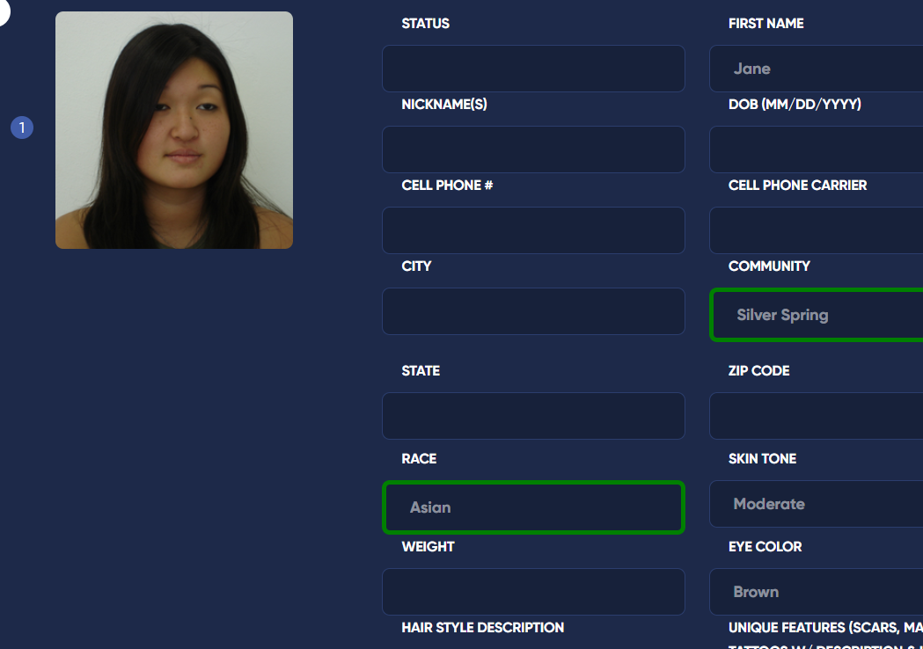
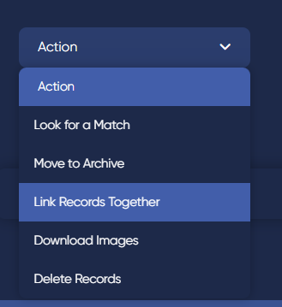
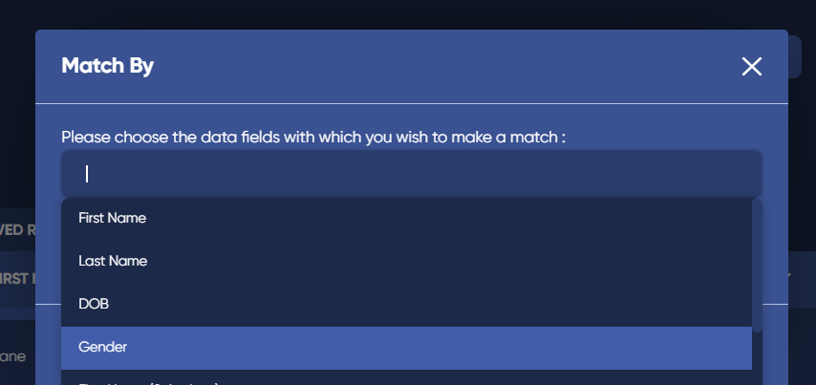
MATCH BY DATA
Use record action menu to request match by data
Select which data fields to match by
Review matched data highlighted in green
If a match, manually link records

Slide 21
LIVCO CONNECTED WORKFLOW
Registry populated by community
Used in-field whenever missing person(s) reported or located
Officer prompts ECC to review potential matches
Data Manager reviews/confirms potential match(es)
Record information shared with responding officer(s)

Slide 22
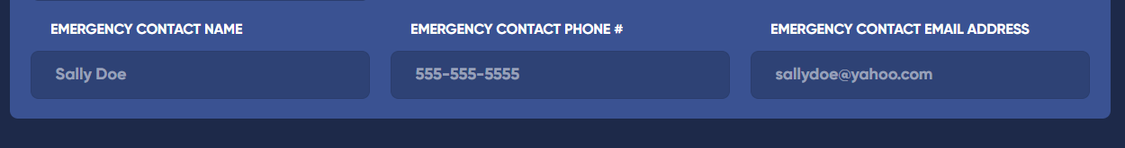
OBTAIN RECORD INFORMATION
If match is verified, review original record for pertinent information
Relay information to officer

Slide 23
ANNUAL REFRESH
Annual data confirmation & refresh
Automated message
Confirm data correct or update
Reminder
Admin outreach if no response
Possible removal

Slide 24
RESOURCES
SOP Template
Training Videos
Recording / Slides
Outreach Materials

Slide 25
QUESTIONS?
  ESGI, LLC
  20448 Peckham St
  Ashburn, VA 20147
  www.esgisolutions.com

